Slide 1
DATA IMPORT/CLEANING
CT127-3-2& Programming for Data Analysis

Slide 2
Topic Learning Outcomes
At the end of this topic, you should be able to:
Understand how to read data from various sources.
Understand how to clean the dataset

Slide 3
Contents & Structure
Data Import
Access data included with R
Read data into a vector or list
Read large data files
Read CSV and Excel files
Read from Databases

Slide 4
Recap From Last Lesson
Various Data Analysis Techniques

Slide 5
1
Access data included with R

Slide 6
Access data included with R
R and some packages come with data included.
To list the data sets in all *available* packages:
data(package = .packages(all.available = TRUE))
To load any data set use the data function:
data(?, package=“?")
Data set name
The package that contain the data set

Slide 7
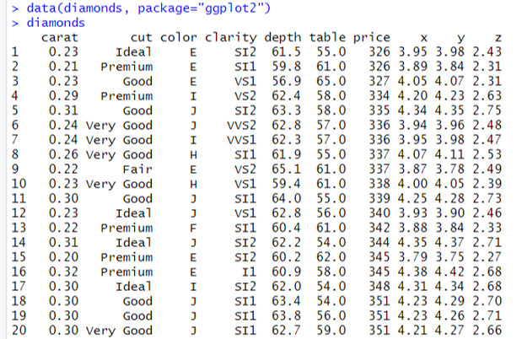
Access data included with R
Example

Slide 8
2
Read data into a vector or list

Slide 9
Read data into a vector or list
Use scan function to read data into a vector or list from the console or file.
IDs= scan(file=“?”)
The path and the name of a file to read data values from

Slide 10
Read data into a vector or list
Example
library(crayon)
IDs= scan(file="C:\\emp.txt")
for(i in IDs)
{
deptID = i %/% 100
if (deptID==1)
{message(red(i))}
else if (deptID==2) {message(green(i))}
else {message(blue(i))}
}
140
253
137
358
279

Slide 11
3
Read large data files

Slide 12
Read large data files
Large files can be slow to read into memory using read.table. fread from the data.table package can be used instead of read.table.
library(data.table)
fread(input=“?”, sep=“?”, header=TRUE)
The full path of the file to be loaded
A logical value indicating whether the file contains the names of the variables as its first line.
The delimiter separating data cells
Example
library(data.table)
f1<-fread(input="c:\\data.csv", sep=",", header=TRUE)

Slide 13
Read large data files
read_delim from the reader package can also be used when working with large data. It returns a tibble, which is an extension of data.frame.
library(reader)
read_delim(file=“?”, delim=“?”, col_names = TRUE)
The full path of the file to be loaded
A logical value indicating whether the file contains the names of the variables as its first line.
The delimiter separating data cells
Example
library(reader)
f2<-read_delim(file="c:\\data.csv", delim=",", col_names =TRUE)

Slide 14
4
Read CSV and Excel files

Slide 15
Read CSV files
A comma-separated values (CSV) file is a delimited text file that uses a comma to separate values.
read.table function is used to read data from a CSV file.
The result of using read.table is a data.frame.
read.csv function, which is a wrapper around read.table with the sep argument preset to a comma (,).

Slide 16
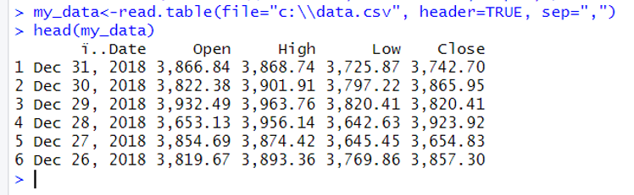
Read CSV files
read.table(file=“?”, header=TRUE, sep=“?")
The full path of the file to be loaded
A logical value indicating whether the file contains the names of the variables as its first line.
The delimiter separating data cells
Example

Slide 17
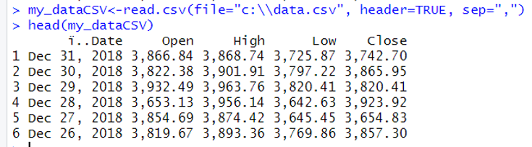
Read CSV files
read.csv(file =“?”, header = TRUE, sep = “,”)
The full path of the file to be loaded
A logical value indicating whether the file contains the names of the variables as its first line.
The delimiter separating data cells
Example

Slide 18
Read Excel files
The package readxl can be used to read Excel files, both .xls and .xlsx.
The result is a tibble rather than a traditional data.frame.
library(readxl)
read_excel(path=“?”, sheet =“?”)
The full path of the file to be loaded
Sheet to read. Either a string (the name of a sheet), or an integer (the position of the sheet)

Slide 19
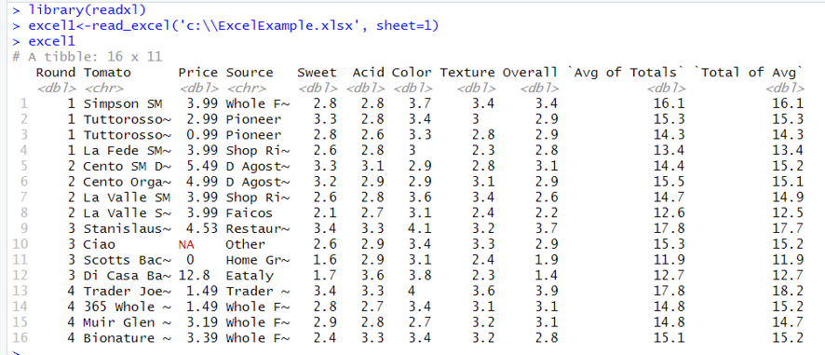
Read Excel files
Example

Slide 20
5
Read from Databases

Slide 21
Read from Databases
There are different types of database software.
The most popular open-source databases have packages such as RPostgreSQL and RMySQL. Other databases without a specific package can make use of the more generic, and aptly named, RODBC package.
Here, a simple SQLite database will be used.

Slide 22
Read from Databases
STEP 1: Load RSQLite library. (Install the library if it is not found in your device.)
library(RSQLite)
STEP 2: Specify the SQLite driver.
drv <- dbDriver('SQLite')
STEP 3: Establish a connection. (Additional arguments are typically the username, password, host, port, the name of the database on the host, or the database file name)
con <- dbConnect(drv, …)

Slide 23
Read from Databases
Example
library(RSQLite)
Load the library
drv <- dbDriver('SQLite')
Specify the driver
Db<-download.file("http://www.jaredlander.com/data/diamonds.db",
destfile = “c:\\ diamonds.db", mode='wb')
con <- dbConnect(drv, "c:\\diamonds.db")
establish a connection
list the tables in a database
> dbListTables(con)
[1] "DiamondColors" "diamonds" "sqlite_stat1"
> dbListFields(con, name='diamonds')
[1] "carat" "cut" "color" "clarity" "depth" "table"
[7] "price" "x" "y" "z"
> dbListFields(con, name='DiamondColors')
[1] "Color" "Description" "Details"
list the fields/columns in a table

Slide 24
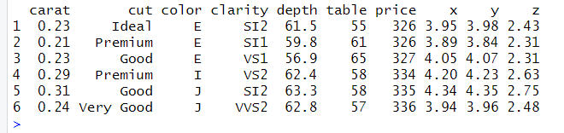
Read from Databases
Example
Retrieve all the elements of all the rows of diamonds table.
library(RSQLite)
drv <- dbDriver('SQLite')
con <- dbConnect(drv, "c:\\diamonds.db")
diamondsTable <- dbGetQuery(con,"SELECT * FROM diamonds",
stringsAsFactors=FALSE)
head(diamondsTable)

Slide 25
DATA CLEANING
Data Cleaning is the process to transform raw data into consistent data that can be easily analyzed.
It is aimed at filtering the content of statistical statements based on the data as well as their reliability.
Purpose of Data Cleaning
The following are the various purposes of data cleaning:
Eliminate Errors
Eliminate Redundancy
Increase Data Reliability
Delivery Accuracy
Ensure Consistency
Assure Completeness
Standardize your approach

Slide 26
Examples:
Special characters (e.g. commas in numeric values)
Rename column names
Numeric values stored as text/character data types
Duplicate rows
Misspellings
Inaccuracies
White space
Missing data
Zeros instead of null values vary.

Slide 27
Exclude duplicate:
Rename column names:

Slide 28
Review Questions
How to access data included with R ?
How to read data into a vector or list?
How to read CSV files?
How to read large data files?
How to read Excel files?
How to read from databases?
How to clean the datasets?

Slide 29
Summary / Recap of Main Points
Access data included with R.
Read data into a vector or list.
Read CSV files.
Read large data files.
Read Excel files.
Read from databases.
Cleaning dataset

Slide 30
What To Expect Next Week
In Class
Preparation for Class
Data Exploration
Data Exploration with sample dataset

